Slide 1
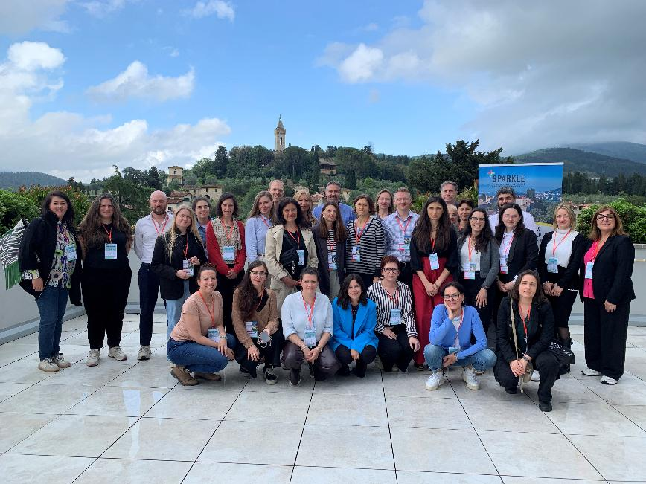
Today
1500 - 1510 Welcome and Introduction:
SPARKLE learning platform, who’s here, challenges and opportunities
1510 - 1520 Marine FABRE, Grenoble Alpes Métropole, Débats pour le climat
1520 – 1525 Guimarães
1520 - 1550 P2P exchange: What can you share? What do you need?
1550 - 1600 Plenary discussion & Closure

Slide 2
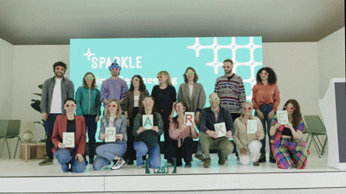
Sustainable Planning and Resilience:
Knowledge Learning Environment

Slide 3



LET’S HELP CITIES ACHIEVE CLIMATE NEUTRALITY
Online training including scenario-modelling tool
Learning Communities /peer-to-peer learning
Study visits and summer schools in 5 lead countries
Practical assignments
Mentoring with local experts

Slide 4

Local Transition Learning Centre
Modules:
Integrated energy and climate transition planning
Data for a clean energy transition
Transition Management: a process for co-creating transformative change
https://localtransitionslearning.eu/mod/page/view.php?id=1264

Slide 5
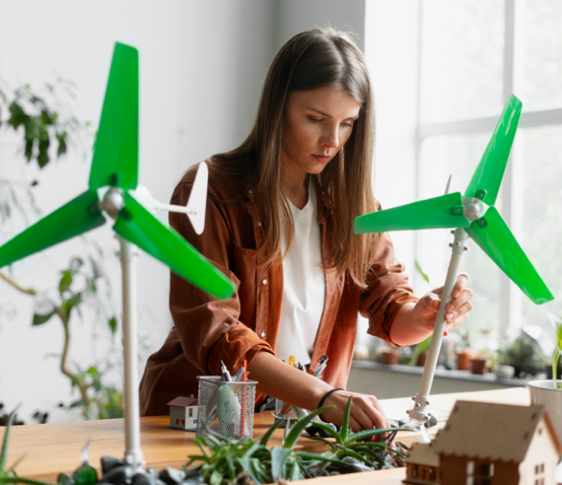
Citizens Assembly Guide
https://energy-cities.eu/publication/local-citizens-assemblies-on-climate-and-energy/
www.energy-cities.eu/sparkle

Slide 6
FIVE DESIGN CHOICES EVERY ASSEMBLY MAKES
1
INITIATE
Usually the city or region. In Stuttgart, a citizen petition with 2,500 signatures led the council to set one up.
2
SELECT
Random selection with criteria for age, gender, area and education. Volunteer pools attract people who are already engaged.
3
REMOVE BARRIERS
Cover the cost of taking part: Brussels pays €75 a day and offers childcare; Grenoble also covered travel.
4
DECIDE
Consensus where possible, otherwise a two-thirds majority. Keep political parties out of the room, as Stuttgart did.
5
FOLLOW THROUGH
The step that decides success: a reasoned response to every proposal and a monitoring committee drawn from the assembly.

Slide 7
THREE IDEAS WORTH BORROWING
ACCOUNTABILITY
WHO COUNTS AS LOCAL
A NEW AUDIENCE
GIPUZKOA
BOLOGNA
LYON
32 citizens, 9 recommendations. The province accepted all of them with timelines and budgets, and reports on progress every year.
80 residents plus 20 "city users": students and commuters. The council explained its decision on every proposal. Budget: about €180,000.
74 randomly selected civil servants used the same method to rethink how the city administration itself works.
ENERGY COMMUNITY LINK
Brussels' housing assembly asked that publicly funded buildings with suitable roofs install solar and join energy community pilots.

Slide 8
YOUR TURN
1
What question would an assembly in your city be asked to answer?
FUNDING ROUTES
Horizon Europe, as for Riga's assembly through CLIMAS
LIFE, which also co-funds Riga
2
What would your council commit to in advance, before hearing the answer?
CERV: citizens' engagement and participation strand
DG REGIO Technical Support with the OECD
3
Who would be hardest to bring into the room, and what would help?

